Slide 1
Online Store Management

Slide 2
Introduction
Welcome everyone to today's presentation on online store management using Spring Boot.
In today's digital age, online stores have become a crucial part of the business landscape.
Managing an online store effectively is essential for success in the competitive e-commerce market.
Spring Boot, a powerful Java framework, provides a robust and efficient solution for developing and managing online stores.

Slide 3
Contd..
In this presentation, we will explore how Spring Boot can help businesses streamline their online store management processes.
We will discuss the key features, architecture, deployment, and scalability considerations of an online store management system built with Spring Boot.
By the end of this presentation, you will have a clear understanding of how Spring Boot can empower your online store management efforts.

Slide 4
Slide 2: Importance of Efficient Management for Online Stores
Online stores face unique challenges compared to traditional brick-and-mortar stores, making efficient management even more critical.
Here are some key reasons why efficient management is essential for online stores:
Customer Satisfaction: Efficient management ensures a seamless shopping experience for customers, leading to higher satisfaction and increased customer loyalty.
Inventory Control: Effective management helps in maintaining accurate inventory levels, preventing stockouts or excess inventory, and optimizing the supply chain.
Order Processing: Efficient order processing ensures timely fulfillment, reducing shipping delays and improving customer satisfaction.
Product Catalog Management: Proper management of product catalogs, including accurate product information, images, and pricing, helps in attracting and retaining customers.
Payment and Security: Efficient management ensures secure payment processing, fraud detection, and compliance with industry regulations, protecting both the business and customers.

Slide 5
Mention the benefits of using Spring Boot for developing online store management systems
Spring Boot, a popular Java framework, offers several benefits for developing online store management systems. Let's explore some of these benefits:
Rapid Development: Spring Boot provides a streamlined development experience with its convention-over-configuration approach. It eliminates boilerplate code, allowing developers to focus on business logic and accelerate development time.
Microservices Architecture: Spring Boot supports the development of microservices, enabling modular and scalable systems. This architecture allows for independent development, deployment, and scaling of different components of the online store management system.
Integration with Spring Ecosystem: Spring Boot seamlessly integrates with other Spring projects like Spring MVC, Spring Data JPA, Spring Security, and Spring Cloud. This integration offers a comprehensive toolkit for building robust and secure online store management systems.
Auto-Configuration: Spring Boot's auto-configuration feature automatically configures the application based on the dependencies present in the classpath. This eliminates the need for manual configuration, reduces development time, and ensures consistency across the application.
Embedded Server: Spring Boot includes an embedded server, such as Tomcat or Jetty, which simplifies deployment and eliminates the need for external server setup. This makes the deployment process more straightforward and portable.

Slide 6
Presentation Layer:
The presentation layer handles user interactions and displays the user interface of the online store management system.
It includes components like web controllers, views, and templates responsible for handling user requests and rendering the appropriate response.
Business Layer:
The business layer contains the core logic and business rules of the online store management system.
It includes components like services, which handle business operations such as inventory management, order processing, and customer management.
The business layer interacts with the data layer to perform CRUD operations on the underlying database.
Data Layer:
The data layer handles data persistence and storage for the online store management system.
It includes components like repositories or DAOs (Data Access Objects), which provide an abstraction for accessing and manipulating data in the database.
The data layer can use technologies like Spring Data JPA or JDBC to interact with the database.

Slide 7
Contd..
External Integrations:
Online store management systems often integrate with external services and APIs for functionalities like payment processing, shipping, and analytics.
These integrations are typically handled through dedicated components or services that communicate with the external systems.
Security:
Security is a crucial aspect of online store management systems to protect sensitive data and prevent unauthorized access.
Spring Security, a powerful security framework, can be used to implement authentication, authorization, and other security measures.
Infrastructure:
The infrastructure layer includes components like the embedded server, database, caching mechanisms, and other infrastructure-related services required for the online store management system to run.
This layered architecture promotes modularity, separation of concerns, and scalability, making it easier to maintain and extend the online store management system as the business grows.

Slide 8
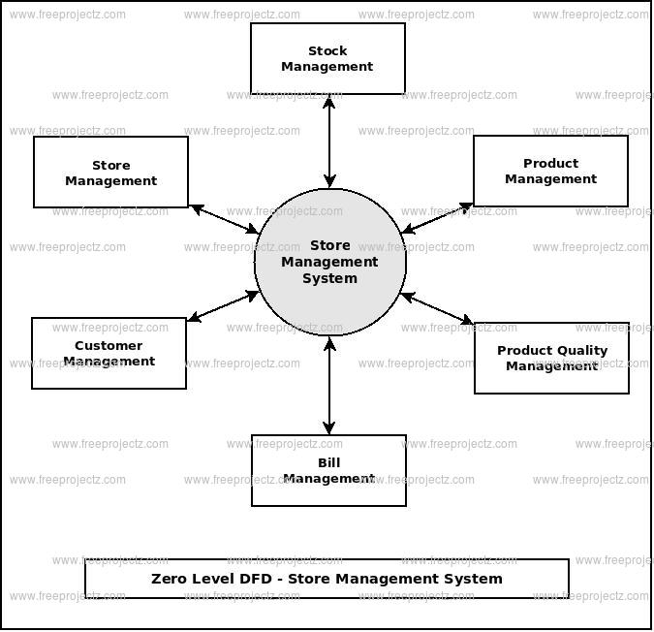
Structure of the Online Store Management

Slide 9
Key Features of Online Store Management System
An online store management system provides a range of features to manage the online store's operations and improve the customer experience. Here are some of the key features of an online store management system:
Product Management:
Add, edit, and delete products and product categories.
Manage inventory levels and stock availability.
Set up pricing, discounts, and promotions.
Order Management:
View and manage customer orders.
Process and fulfill orders efficiently.
Provide order tracking and status updates to customers.

Slide 10
Customer Management:
Manage customer accounts and profiles.
Track and analyze customer behavior and preferences.
Provide personalized recommendations and promotions.
Payment and Shipping:
Integrate with popular payment gateways to provide secure payment processing.
Manage shipping and logistics, including shipping rates and delivery options.
Provide real-time shipping quotes and tracking information

Slide 11
Security:
Implement robust security measures to protect customer data and prevent fraud.
Ensure compliance with relevant regulations and standards.
Provide secure payment processing and data encryption.
These features enable businesses to provide a seamless and engaging online shopping experience, increase customer satisfaction, and improve operational efficiency.

Slide 12
Spring Boot Modules Used in the System
Spring MVC for handling HTTP requests and responses
Spring Data JPA for database access and entity management
Spring Security for authentication and authorization
Spring Cloud for microservices architecture

Slide 13
Database Design
Product Table:
Contains details about products, such as product ID, name, description, price, and inventory information.
Allows for efficient product management and retrieval
OrderDetails Table:
Stores details about customer orders, such as order ID, customer ID, order date, and total amount,Quantity and CustomerAddres.
Facilitates order management and tracking.
Store table:
store table to store the storeId,storeName, and List of Products.

Slide 14
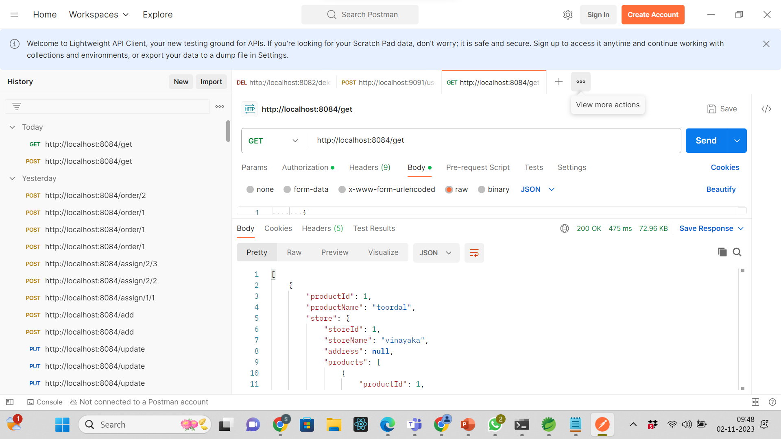
User Interface Design

Slide 15
To Add product

